Slide 1
Spatial Models
Presented By :- Snehal Tawar

Slide 2


Table Of Contents:
1) Introduction
2) Data Models for Spatial data
3) Logical Data Model
4) Physical Data Model

Slide 3
Spatial data, which means data related to space. Non-spatial data ( also called attribute or characteristic data) is that information which is independent of all geometric considerations. Two types of spatial data are particularly important: • Computer-aided-design (CAD) data, which includes spatial information about how objects such as buildings, cars, or aircraft, are constructed. Other important examples of computer-aided-design databases are integrated-circuit and electronic-device layouts. • Geographic data such as road maps, land-usage maps, topographic elevation maps, political maps showing boundaries, land-ownership maps, and so on. Geographic information systems are special-purpose databases tailored for storing geographic data. A spatial database system is a full-fledged database system with additional capabilities for handling spatial data. Spatial data types include Point, line, region.

Slide 4
Data Models for Spatial Data
Data structures are complex for GIS because they must include information pertaining to entities with respect to: position, topological relationships, and attribute information. It is the topologic and spatial aspects of GIS that distinguish it from other types of data bases.
There are presently three types of representations for geographic data: raster vector, and objects.
raster - set of cells on a grid that represents an entity (entity --> symbol/color --> cells).
vector -an entity is represented by nodes and their connecting arc or line segment (entity --> points, lines or areas --> connectivity)
object – an entity is represented by an object which has as one of its attributes spatial information.

Slide 5
Logical data models for spatial databases: rastor and vector model :
Raster Data model:
Realization of the external model which sees the world as a continuously varying surface (field) through the use of 2-D Cartesian arrays forming sets of thematic layers. Space is discretized into a set of connected two dimensional units called a tessellation.
Vector data model:
Realization of the discrete model of real world using structures for storing and relating points, lines and polygons in sets of thematic layers.

Slide 6
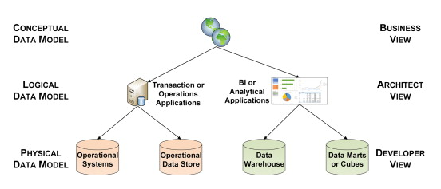
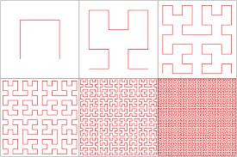
Physical data models for spatial databases: Clustering methods (space filling curves) –
A space filling curve is a way of mapping a multi-dimensional space into a one dimensional space. Also called as the Hilbert curve first described by the German mathematician David Hilbert in 1891.

Slide 7

THANK YOU !

